Slide 1
DECISION SUPPORT SYSTEM (DSS) Weighted SUM Model (WSM) Weighted PRODUCT Model (WPM)
TEACHING TEAM
DECISION SUPPORT SYSTEM COURSE IN 24/25

Slide 2

Weighted SUM Model (WSM)
Also known as Weighted Linear Combination (WLC) or Sum Additive Weighting (SAW)
Using the principle additive utility assumption → Alternative final grades based on the addition of values from the criteria
Suitable for use in single-dimensional conditions or all criteria have the same unit

Slide 3
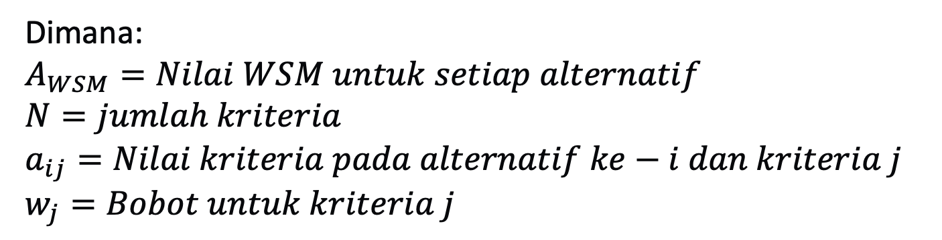
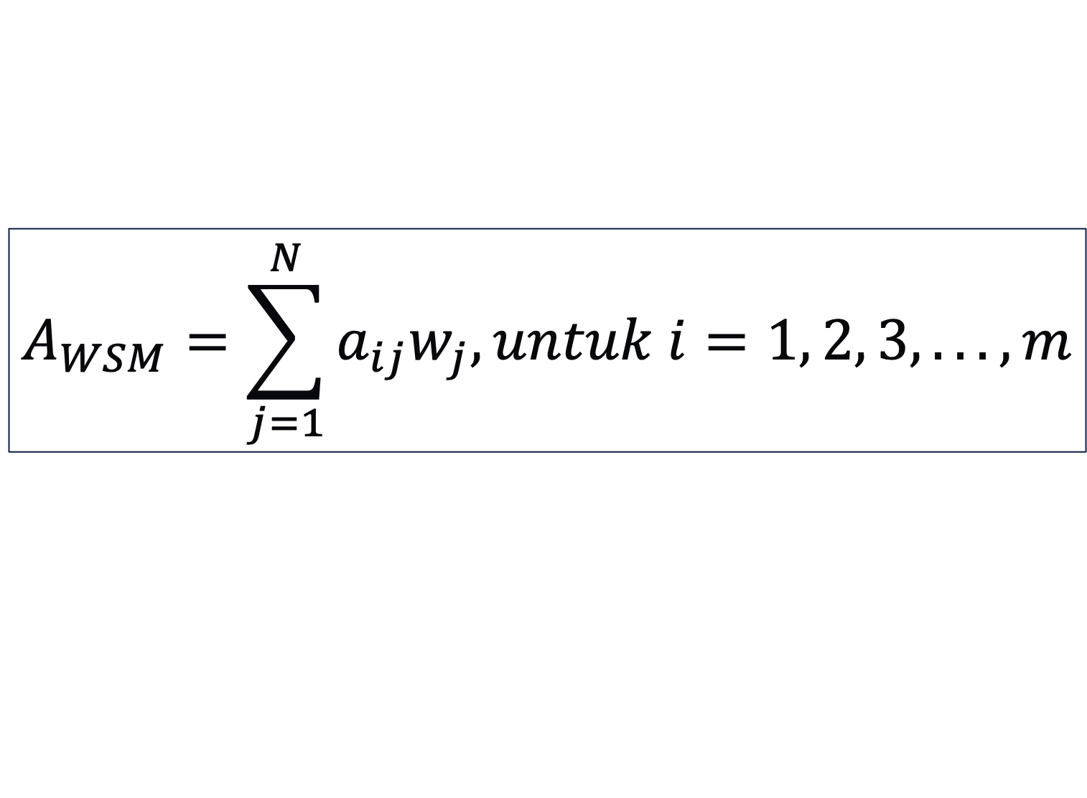
Preferred values on WSM
$$A_{WSM}=\sum_{j=1}^{N}{a_{ij}w_{j}, untuk i=1, 2, 3, . .., m}$$
Where:
$$A_{WSM}=Nilai WSM untuk setiap alternatif \\ N=jumlah kriteria \\ a_{ij}=Nilai kriteria pada alternatif ke−i dan kriteria j \\ w_{j}=Bobot untuk kriteria j$$

Slide 4
Decision Making Steps at MADM
Understand the problem and the purpose of decision-making
Determining alternatives (A_{1…}A_{m})
Define criteria (C₁…C_{n})
Determining the value of each criterion for each alternative
Normalize the value of each criterion for each alternative
Determining the weight of each criterion (w₁…w_{n})
Calculate alternative values
Sensitivity test

Slide 5
Case Study 1 – Creditworthiness
The case of determining creditworthiness in several prospective creditors.
In this case, there are four prospective creditors who will be determined to be eligible to receive credit, namely:
Ibu Lestari
Bapak Amir
Bapak Joko
Ibu Siti
These four prospective creditors are referred to as Alternative (A), which is the choice that will be chosen by the decision maker, so it is determined:
Ibu Lestari → A1
Bapak Amir → A2
Bapak Joko → A3
Ibu Siti → A4

Slide 6
Case Study 1 – Creditworthiness
The criteria or conditions for determining creditworthiness are referred to as Criteria (C), while the weight to determine the level of importance of the criteria, is determined:
Criteria (Weight)
C1 → Private Character (10%)
C2 → Credit Status (10%)
C3 → Business Condition (25%)
C4 → Earnings (20%)
C5 → Warranty (15%)
C6 → Warranty Condition (15%)
C7 → Installment (5%)
Example of Criterion Value Scale
No | Scale Value | Value
1 | Good | 100
2 | Enough | 80
3 | Less | 50
Normalization
Attribut Benefit:
rij = Sij / max(Sij)
Attribut Cost:
rij = min(Sij) / Sij

Slide 7
Case Study 1 – Tabulation of Criteria Values for Each Alternative
The following is a decision matrix that represents the relationship between the four alternatives and the seven criteria used in the case study of determining creditworthiness.
How to determine the ranking order of prospective creditors who are eligible to receive credit?
Credit Eligibility Decision Matrix
 | Criteria
Alt | C1 | C2 | C3 | C4 | C5 | C6 | C7
A1 | 80 | 100 | 80 | 100 | 75 | 100 | 80
A2 | 50 | 100 | 100 | 80 | 75 | 100 | 80
A3 | 100 | 80 | 80 | 60 | 75 | 80 | 60
A4 | 100 | 80 | 80 | 80 | 75 | 60 | 80

Slide 8
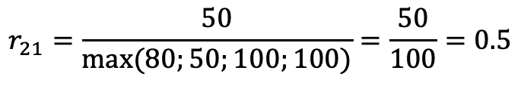
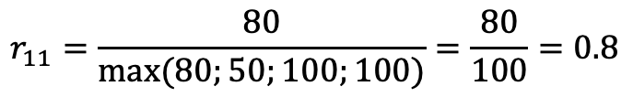
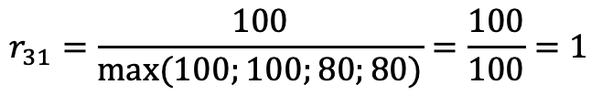
Step 1 – Normalize the value
 | Criteria
Alt | C1 | C2 | C3 | C4 | C5 | C6 | C7
A1 | 80 | 100 | 80 | 100 | 75 | 100 | 80
A2 | 50 | 100 | 100 | 80 | 75 | 100 | 80
A3 | 100 | 80 | 80 | 60 | 75 | 80 | 60
A4 | 100 | 80 | 80 | 80 | 75 | 60 | 80
Example:
$$r_{11}=\frac{80}{max⁡(80;50;100;100)}=\frac{80}{100}=0.8$$
$$r_{21}=\frac{50}{max⁡(80;50;100;100)}=\frac{50}{100}=0.5$$
$$r_{31}=\frac{100}{max⁡(100;100;80;80)}=\frac{100}{100}=1$$
 | Criteria
Alt | C1 | C2 | C3 | C4 | C5 | C6 | C7
A1 | 0.8 | 1 | 0.8 | 1 | 1 | 1 | 1
A2 | 0.5 | 1 | 1 | 0.8 | 1 | 1 | 1
A3 | 1 | 0.8 | 0.8 | 0.6 | 1 | 0.8 | 0.75
A4 | 1 | 0.8 | 0.8 | 0.8 | 1 | 0.6 | 1
0.8
0.8
1
1
Normalization matrix

Slide 9
Step 2 – Calculate the Weight
 | Criteria
w | 0.1 | 0.1 | 0.25 | 0.2 | 0.15 | 0.15 | 0.05
Alt | C1 | C2 | C3 | C4 | C5 | C6 | C7
A1 | 0.8 | 1 | 0.8 | 1 | 1 | 1 | 1
A2 | 0.5 | 1 | 1 | 0.8 | 1 | 1 | 1
A3 | 1 | 0.8 | 0.8 | 0.6 | 1 | 0.8 | 0.75
A4 | 1 | 0.8 | 0.8 | 0.8 | 1 | 0.6 | 1
0.8
0.8
1
1
Multiply the weight by the value of r_{ij}
 | Criteria
w | 0.1 | 0.1 | 0.25 | 0.2 | 0.15 | 0.15 | 0.05
Alt | C1 | C2 | C3 | C4 | C5 | C6 | C7
A1 | 0.08 | 0.1 | 0.2 | 0.2 | 0.15 | 0.15 | 0.05
A2 | 0.05 | 0.1 | 0.25 | 0.16 | 0.15 | 0.15 | 0.05
A3 | 0.1 | 0.08 | 0.2 | 0.12 | 0.15 | 0.09 | 0.0375
A4 | 0.1 | 0.08 | 0.2 | 0.16 | 0.15 | 0.12 | 0.05
0.08
0.08
0.1
0.1

Slide 10
Step 3 - Add the Criteria Values
 | Criteria
Alt | C1 | C2 | C3 | C4 | C5 | C6 | C7 | WSM
A1 | 0.08 | 0.1 | 0.2 | 0.2 | 0.15 | 0.15 | 0.05 | 0.91
A2 | 0.05 | 0.1 | 0.25 | 0.16 | 0.15 | 0.15 | 0.05 | 0.89
A3 | 0.1 | 0.08 | 0.2 | 0.12 | 0.15 | 0.09 | 0.0375 | 0.7975
A4 | 0.1 | 0.08 | 0.2 | 0.16 | 0.15 | 0.12 | 0.05 | 0.88
0.08
0.08
0.1
0.1

Slide 11
Step 4 – Ranking
 | Criteria
Alt | C1 | C2 | C3 | C4 | C5 | C6 | C7 | WSM
A1 | 0.08 | 0.08 | 0.2 | 0.2 | 0.15 | 0.15 | 0.05 | 0.91
A2 | 0.05 | 0.08 | 0.25 | 0.16 | 0.15 | 0.15 | 0.05 | 0.89
A3 | 0.1 | 0.1 | 0.2 | 0.12 | 0.15 | 0.09 | 0.0375 | 0.7975
A4 | 0.1 | 0.1 | 0.2 | 0.16 | 0.15 | 0.12 | 0.05 | 0.88
So, the alternative ranking order is,
A1 > A2 > A4 > A3
Rank 1: Ibu Lestari
Rank 2: Bapak Amir
Rank 3: Ibu Siti
Rank 4: Bapak Joko

Slide 12
Weighted PRODUCT Model (WPM)
Similar to WSM, only in WPM a multiplication operation is carried out
WPM is dimensionless because its structure can eliminate the units used
Due to the dimensionless nature of WPM can be used on different criteria unit conditions

Slide 13
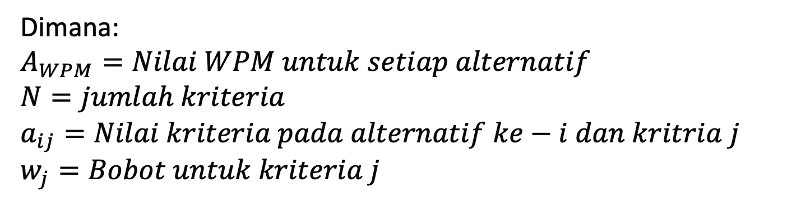
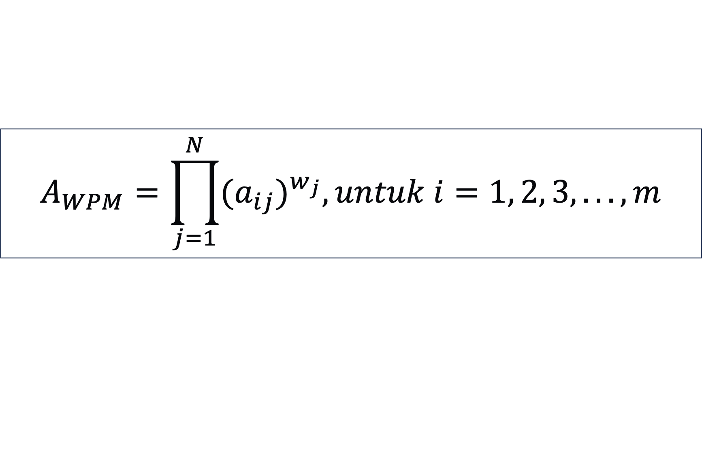
Values preference on WPM
$$A_{WPM}=\prod_{j=1}^{N}{{{(a}_{ij})}^{w_{j}}, untuk i=1, 2, 3, . .., m}$$
Dimana:
$$A_{WPM}=Nilai WPM untuk setiap alternatif \\ N=jumlah kriteria \\ a_{ij}=Nilai kriteria pada alternatif ke−i dan kritria j \\ w_{j}=Bobot untuk kriteria j$$

Slide 14
Implementation in the same case ☺
Criteria (Weight)
C1 → Private Character (10%)
C2 → Credit Status (10%)
C3 → Business Condition (25%)
C4 → Earnings (20%)
C5 → Warranty (15%)
C6 → Warranty Condition (15%)
C7 → Installment (5%)
Example of Criterion Value Scale
No | Scale Value | Value
1 | Good | 100
2 | Enough | 80
3 | Less | 50
Normalization
Attribut Benefit:
rij = Sij / max(Sij)
Attribut Cost:
rij = min(Sij) / Sij

Slide 15
Fast Forward to Normalization
 | Criteria
w | 0.1 | 0.1 | 0.25 | 0.2 | 0.15 | 0.15 | 0.05
Alt | C1 | C2 | C3 | C4 | C5 | C6 | C7
A1 | 0.8 | 1 | 0.8 | 1 | 1 | 1 | 1
A2 | 0.5 | 1 | 1 | 0.8 | 1 | 1 | 1
A3 | 1 | 0.8 | 0.8 | 0.6 | 1 | 0.6 | 0.75
A4 | 1 | 0.8 | 0.8 | 0.8 | 1 | 0.8 | 1
Note:
The WPM normalization process is the same as the WSM normalization process We can use the same technique

Slide 16
Step 2 / 3 – Calculate the Weight and Value of the WPM
 | Criteria
w | 0.1 | 0.1 | 0.25 | 0.2 | 0.15 | 0.15 | 0.05
Alt | C1 | C2 | C3 | C4 | C5 | C6 | C7
A1 | 0.8 | 1 | 0.8 | 1 | 1 | 1 | 1
A2 | 0.5 | 1 | 1 | 0.8 | 1 | 1 | 1
A3 | 1 | 0.8 | 0.8 | 0.6 | 1 | 0.6 | 0.75
A4 | 1 | 0.8 | 0.8 | 0.8 | 1 | 0.8 | 1
$$A1_{wpm}={0.8}^{0.1}∗1^{0.1}∗{0.8}^{0.25}∗1^{0.2}∗1^{0.15}∗1^{0.15}∗1^{0.05}$$

Slide 17
Step 4 - Ranking
Alt | WPM
A1 | 9.25E-01
A2 | 8.92E-01
A3 | 7.62E-01
A4 | 8.55E-01
So, the alternative ranking order is,
A1 > A2 > A4 > A3
Rank 1: Ibu Lestari
Rank 2: Bapak Amir
Rank 3: Ibu Siti
Rank 4: Bapak Joko

Slide 18

Terima Kasih
Jobsheet time!

